Slide 1
Geospatial Highlights in Latvia
Arnis Daugulis
Deputy State Secretary for
ICT and eGovernment

Slide 2
Latvia
1,9 mio population
3rd fastest internet in EU
3 of 4 citizens use i-banks
89% of companies return forms over the internet
Digital Access Right
Government and Public Utility Services
Notes:
2

Slide 3
Digital by default
All legislative acts on national and EU level
should fit for digital age
Every public service and process – eEnabled
Every sector and policy area – ICT boosted

Slide 4
Vision for government – open, efficient, user oriented and collaborative
User-oriented design of services
Shared and re-used
Open data and services
Secure & Interoperable by design

Slide 5
Geo-data matter for everyone
Geospatial info - not only for professionals
Need for geo-data support for decision making is growing in different sectors
Value of geo-location data grows when shared
Across domains
Between Public & Private
Across borders

Slide 6
Business intelligence
eServices
Geo-products
INSPIRE Portal
Data exchange &
Shared services platform
BIS
GEO business systems
Public & Private data sources

Slide 8
GeoPortal
Geo data integration platform

Slide 9
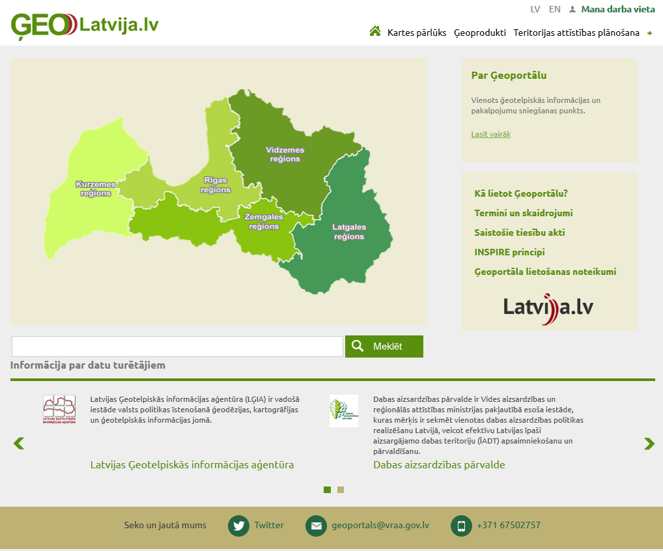
Single access point for Geo data, incl. INSPIRE
Data from Public & Private data owners
Tools to create and manage Geo content
Shared components to create & Provide/Sell Geo products

Slide 10
Map Viewer

Slide 11
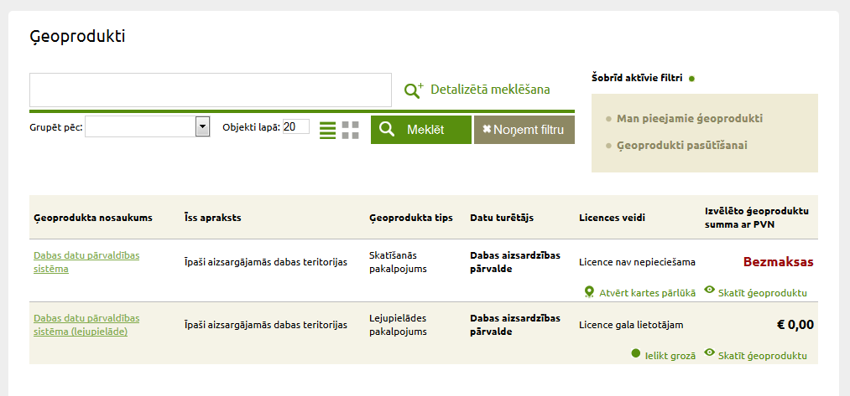
Geoproducts

Slide 12
Spatial planning information system

Slide 13
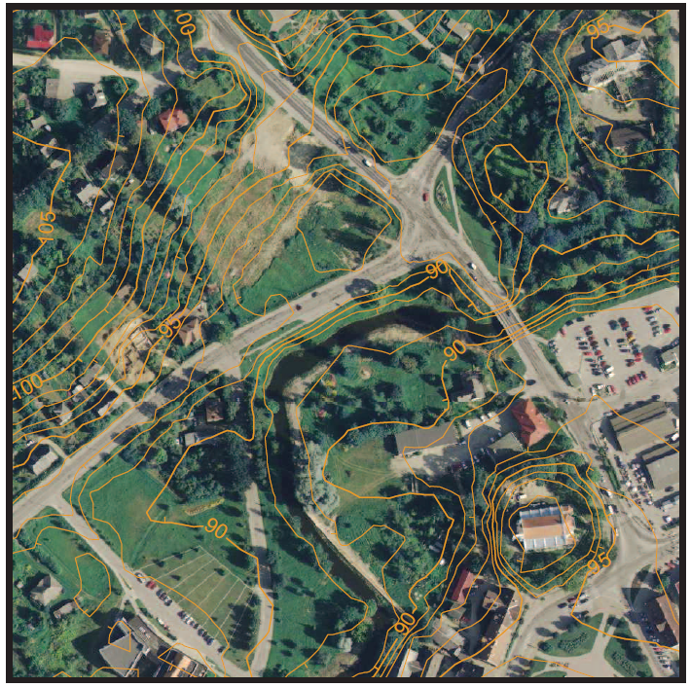
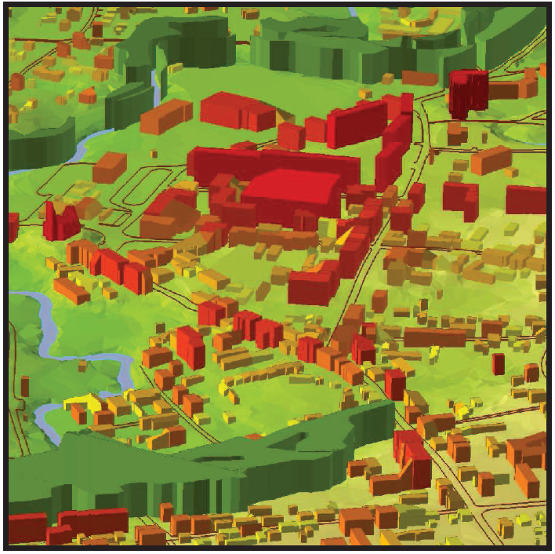
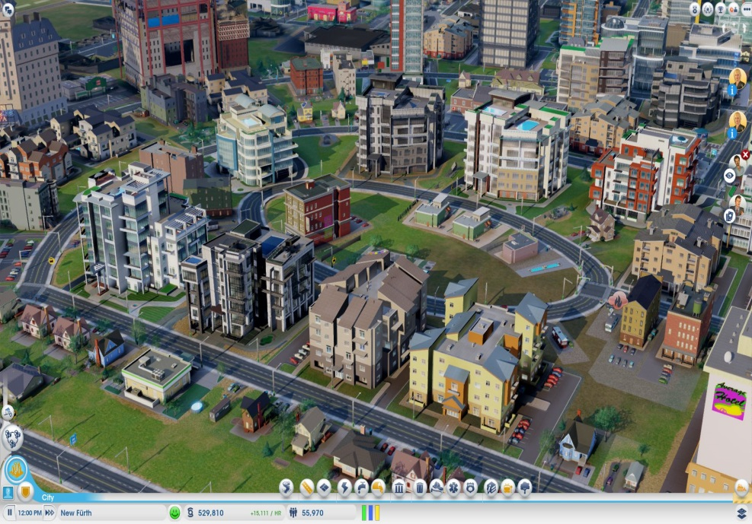
100% digital Spatial planning
Availability of core Geo data for planners
Standardized workflow of spatial development
Public access of documents and information
Location based eServices for citizens (notifications)
Mandatory from
May 1, 2015

Slide 14
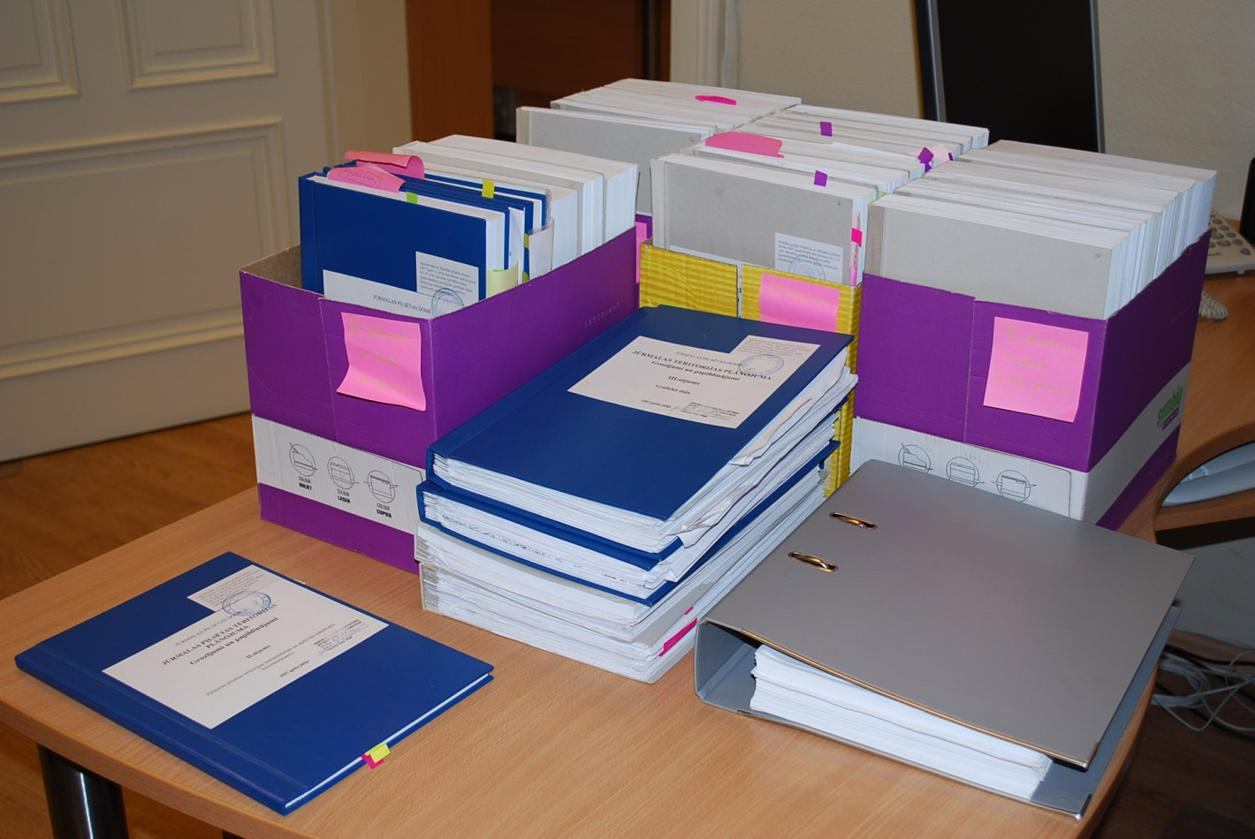
Amendmends for Jūrmala’s city spatial plan

Slide 15
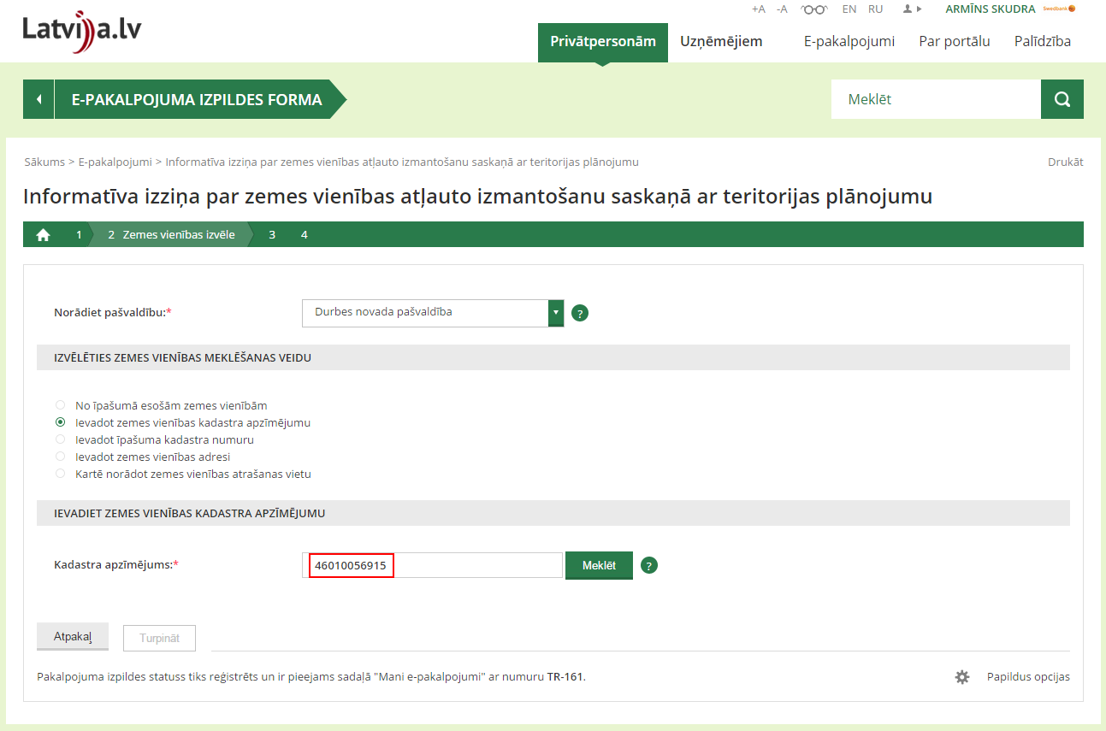
Spatial analysis data request (on permitted use of territory)
eService

Slide 16
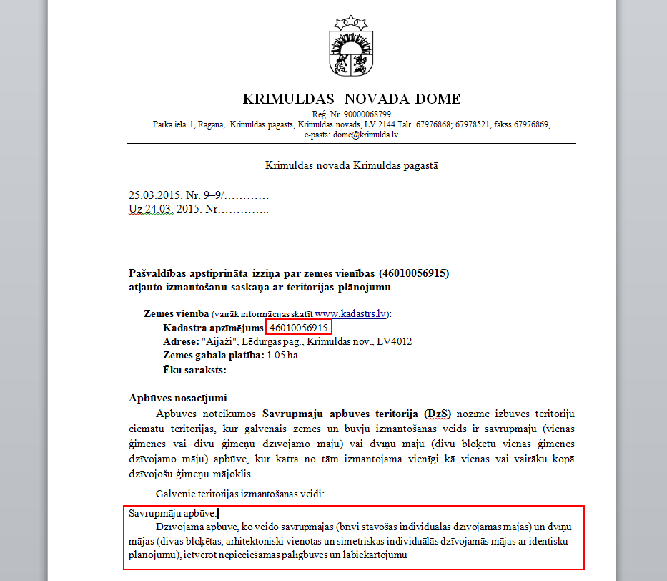
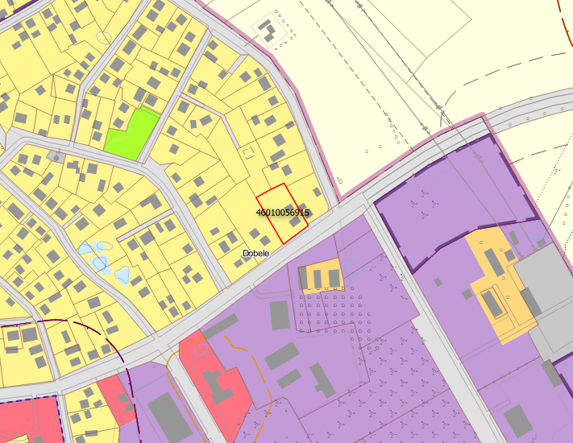
Spatial analysis data request (on permitted use of territory)
eService

Slide 17
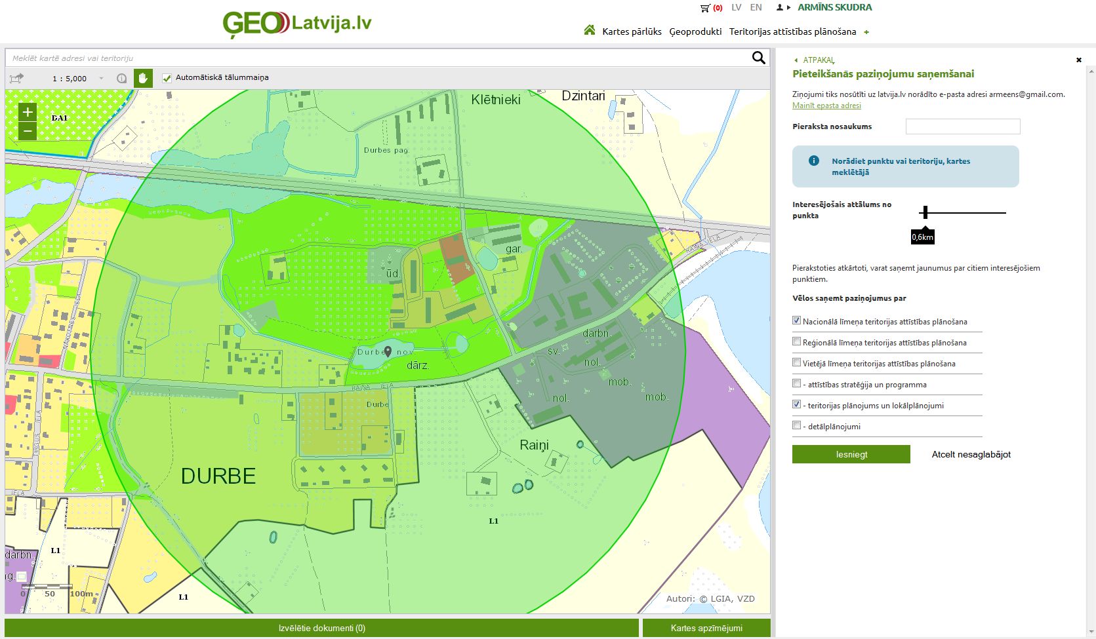
Request for notification on changes in spatial plan
eService

Slide 18
Regional Development Indicators Module

Slide 19
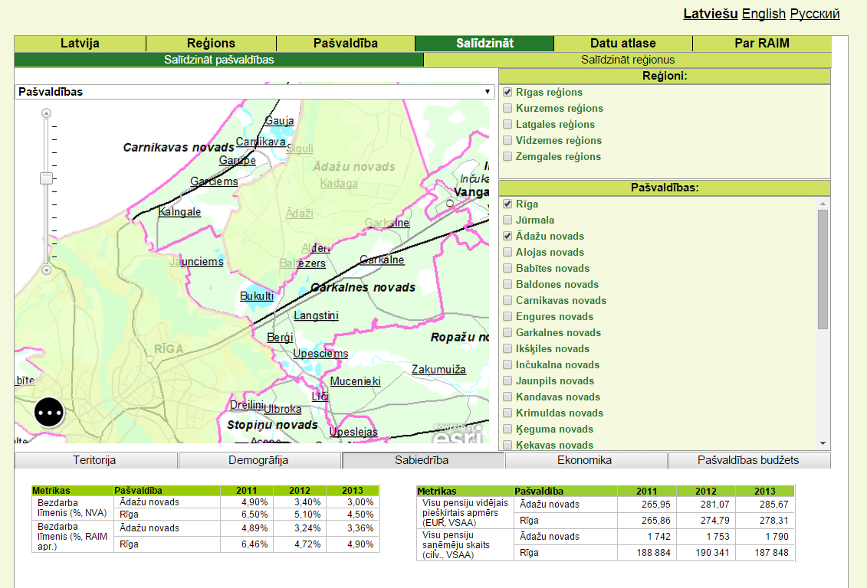

Slide 20
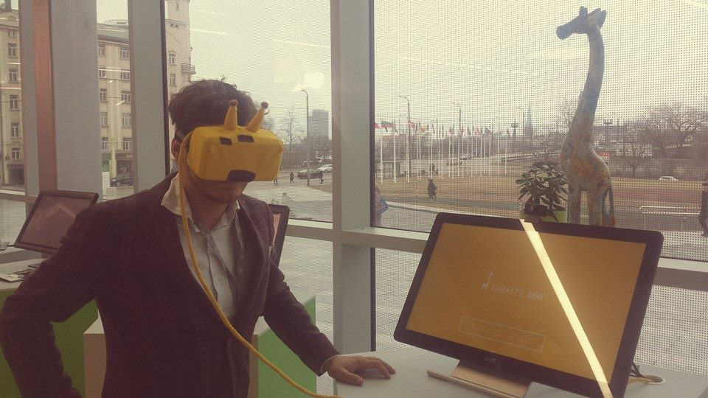
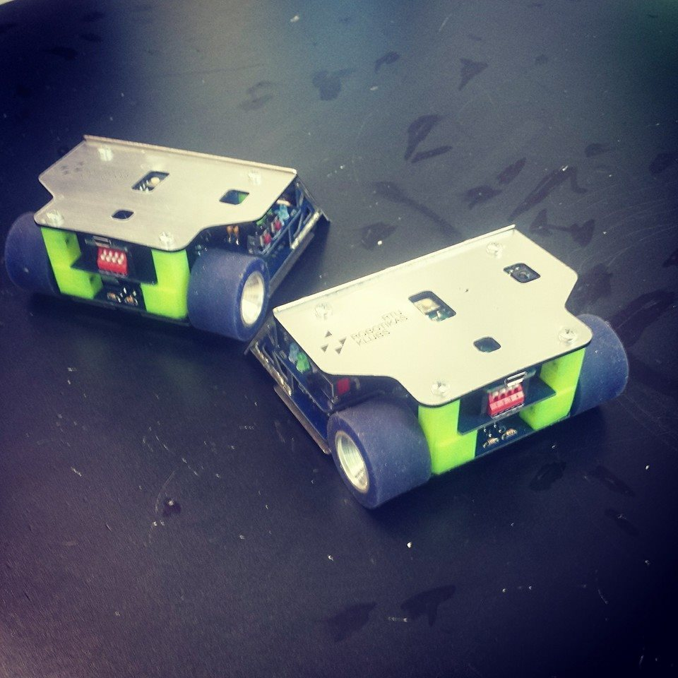
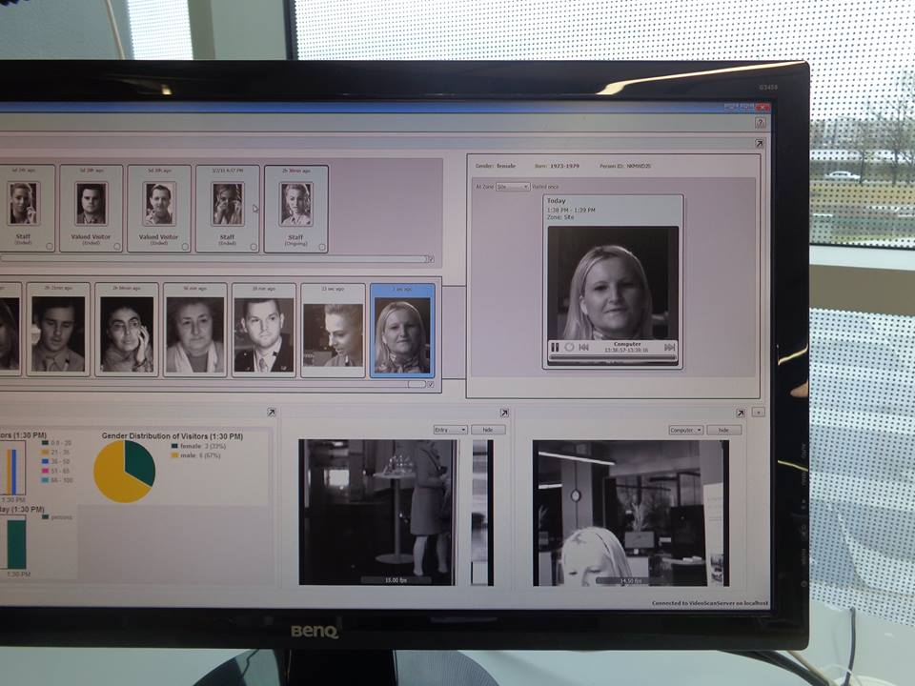
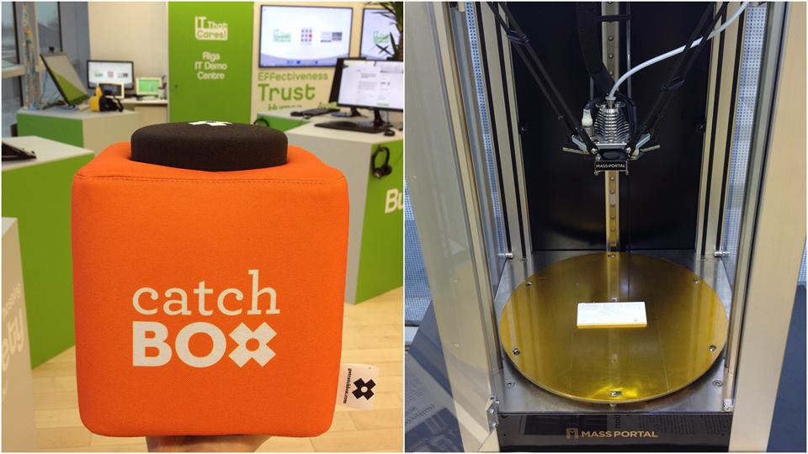
Welcome to
Riga IT Demo Centre
rigaitdemocentre.com
take a virtual tour of Latvian IT solution portfolio

Slide 21
Paldies!
facebook.com/IfYouLikeLatviaLatviaLikesYou
EU2015.lv
@EU2015LV
EU2015LV

